Slide 1
How to Explain Things Guidelines for Effective Scientific Communication
Trevor Campbell
Assistant Professor
UBC Statistics

Slide 2

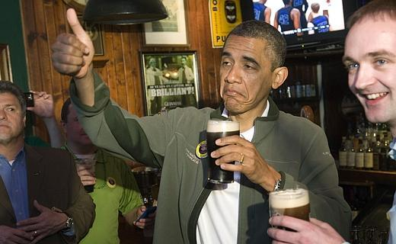
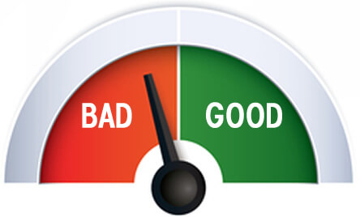

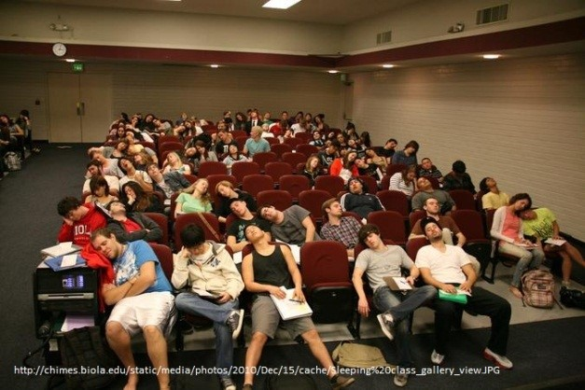

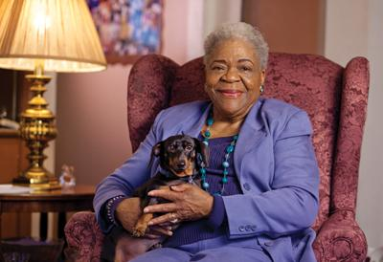
The research loop
your skeptical supervisor
you’ve just done some research! now you have to explain it to:
for every 1 unit of work time, you create 100 units of explaining time
how well you communicate will have a huge impact on your career
reviewers again
reviewers again
reviewers
goto start
a conference audience
an interviewer
your grandma
x 100

Slide 3
Communication is a grey area
I was trained as an engineer. I don’t like grey areas.
So I made a set of guidelines for scientific communication.
applies to papers, talks, posters, interviews, etc.
Goal: concrete material creation pipeline
structure (high level)
content (mid level)
polish
(low level)
research

Slide 4
Let’s start with a brief experiment
I’ll show you 2 lists of characters and give you 5 seconds to memorize each
adaatatiwqdhtasgattwdt
adaatat

Slide 5
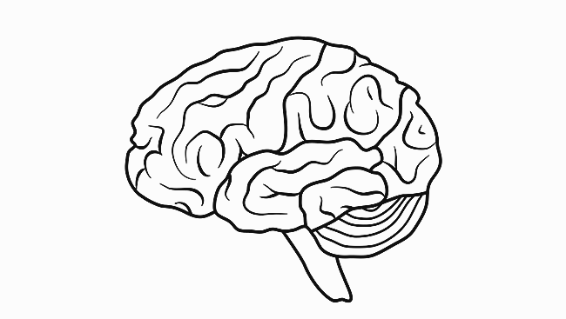
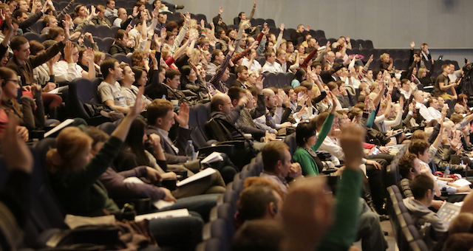
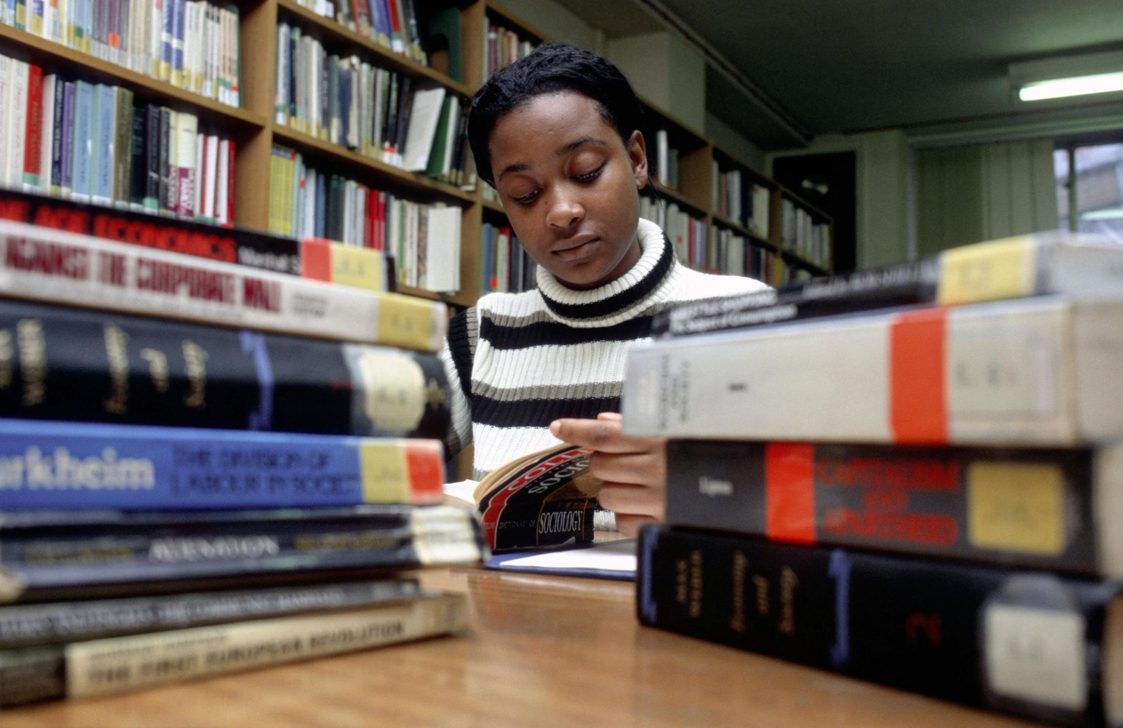
We suck at remembering things
roughly two kinds of storage in our brains*
working memory
long-term memory
capacity: 4-7 items^{1,2} duration: < 30s³
capacity: large duration: long
your paper / talk / poster audience is only using their working memory
i.e., they can’t remember what you said 1 slide / paragraph ago
*diagram almost certainly not anatomically correct

Slide 6

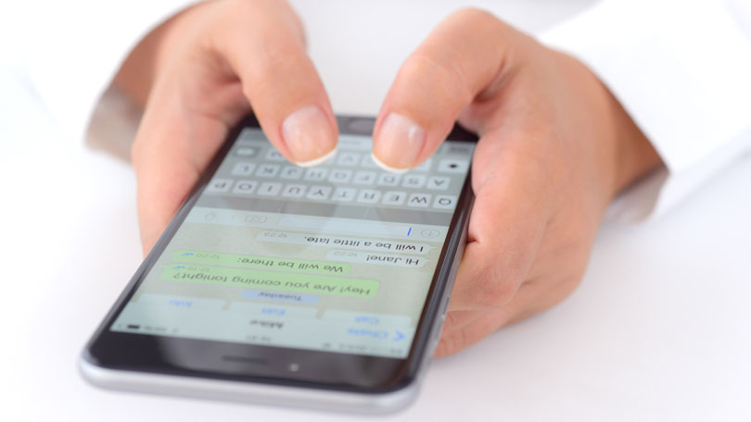
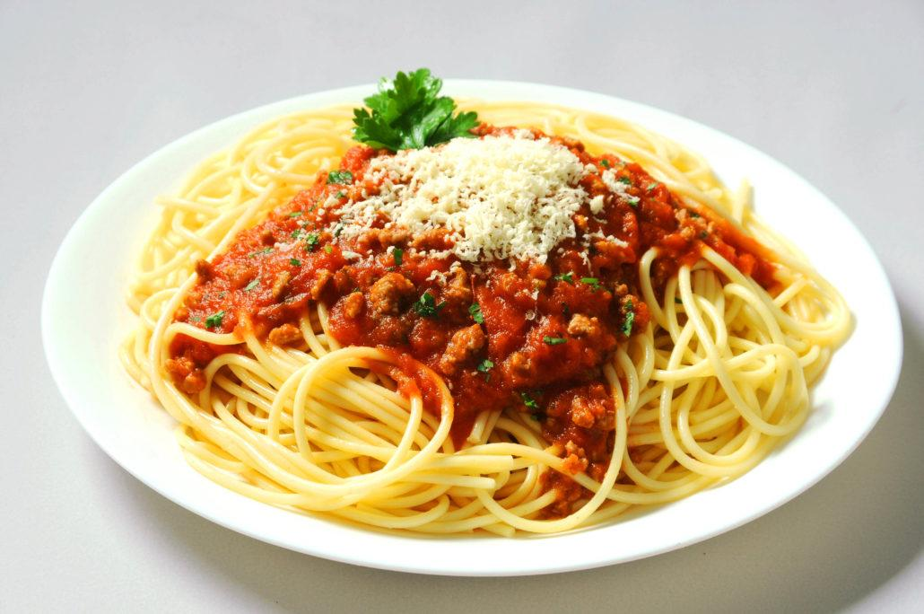
We also suck at multitasking
“It turns out multitaskers are terrible at every aspect of multitasking.
They're terrible at ignoring irrelevant information;
they're terrible at keeping information in their head nicely and neatly organized;
and they're terrible at switching from one task to another”
Clifford Nass, Professor of Communication, Stanford University⁵
your audience is also probably distracted
we are very inefficient at context switching⁴
i.e., even if they were capable of remembering what you said 1 slide ago, they still won’t because they weren’t paying attention

Slide 7
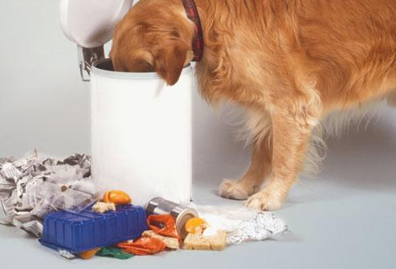
A brief experiment, redux
Let’s memorize a story instead of a list of characters (try to picture it in your head)
A dog ate a treat and thought it was quite delicious. He then ate some garbage and thought that was delicious too.
A dog ate a treat and thought it was quite delicious. He then ate some garbage and thought that was delicious too.
adaatatiwqdhtasgattwdt
Also a great way to make secure & easy-to-remember passwords!

Slide 8
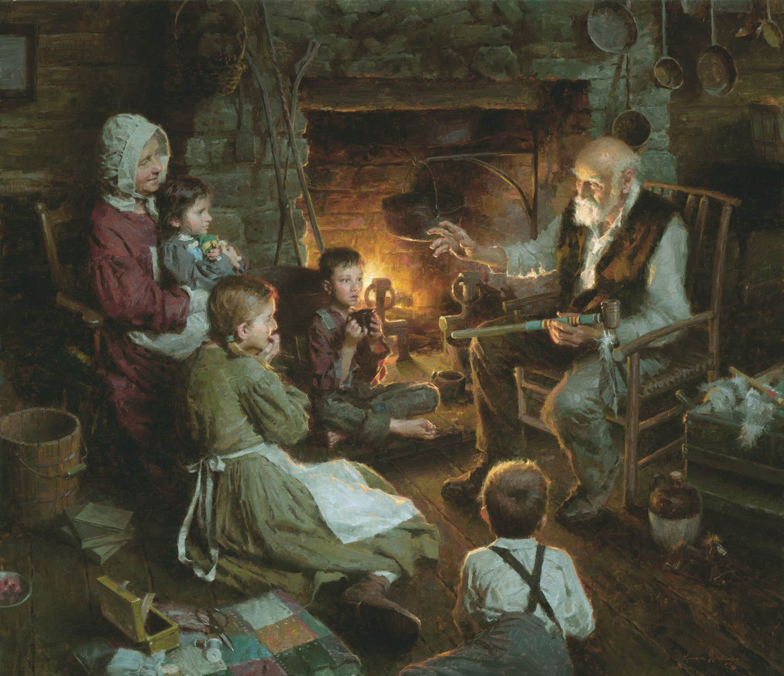
We aren’t too bad with stories
Research shows that good story telling
is a more effective teaching method⁶
“couples brains”⁷
is linked to increased social cooperation⁸
Suggests the natural structure for a paper/talk is a story

Slide 9
OK, what’s the point?
These ideas suggest two rules about communicating:
Rule 1
Minimize cognitive load.
Rule 2
Present your research as a story.
not doing this is by far the #1 pitfall I see in talks

Slide 10
Putting them into practice
This talk: three major steps of research media creation
Plan the story, focusing flow of high-level ideas
Provide details using the minimum data necessary
Apply polish / finishing touches
I literally mean audiovisual bits here

Slide 11
1. Crafting the Story
problem-solution and unpacking

Slide 12
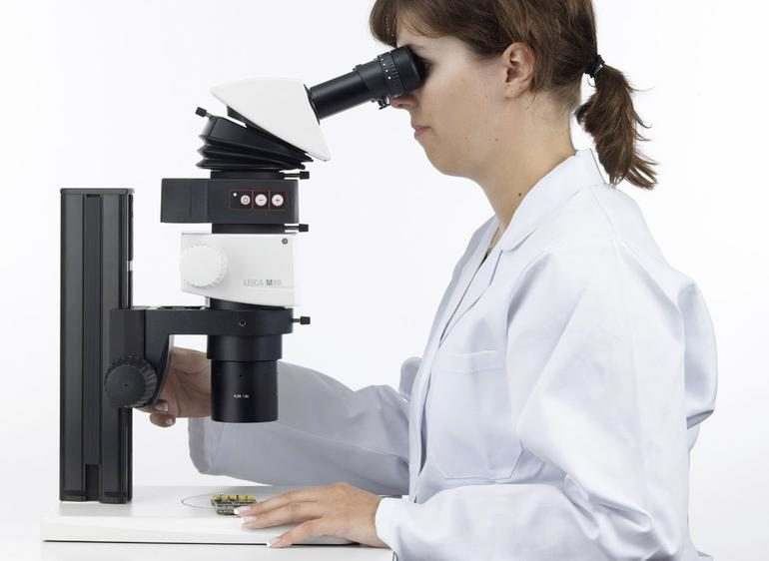
Figure out what you did
You’ve been focused research minutiae for months / years
Your Perspective
your
research
take a step back and recall / amend the big picture story

Slide 13
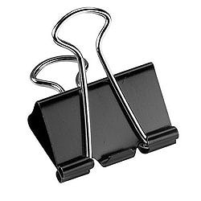
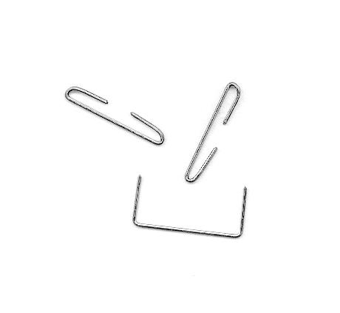
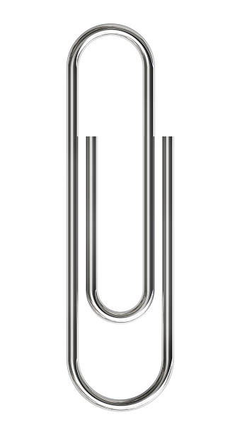
Problem-Solution
My technique for this is problem-solution
Automatically creates a logic flow & “zooms in”
problem: I want to keep papers in order
This is your research
scope
solution: stick them together
specific problem
problem: reusable holder for lots of paper
helps focus on “why,” a little bit of “what,” and no “how”
solution: a staple
problem: not reusable, can’t hold much
previous work
it’s awesome
but nobody knows why you did it
solution: a paperclip
problem: flimsy, can’t hold much
your solution
solution: your new clip thingy!

Slide 14
Example from one of my papers⁹
Kernel methods offer the flexibility to learn complex relationships in modern, large data sets while enjoying strong theoretical guarantees on quality.
problem, solution
Unfortunately, these methods typically require cubic running time in the data set size, a prohibitive cost in the large-data setting.
problem
Random feature maps (RFMs) and the Nyström method both consider low-rank approximations to the kernel matrix as a potential solution.
solution
But, in order to achieve desirable theoretical guarantees, the former may require a prohibitively large number of features, and the latter may be prohibitively expensive for high-dimensional problems.
problem
We propose to combine the simplicity and generality of RFMs with a data-dependent feature selection scheme to achieve…
solution

Slide 15
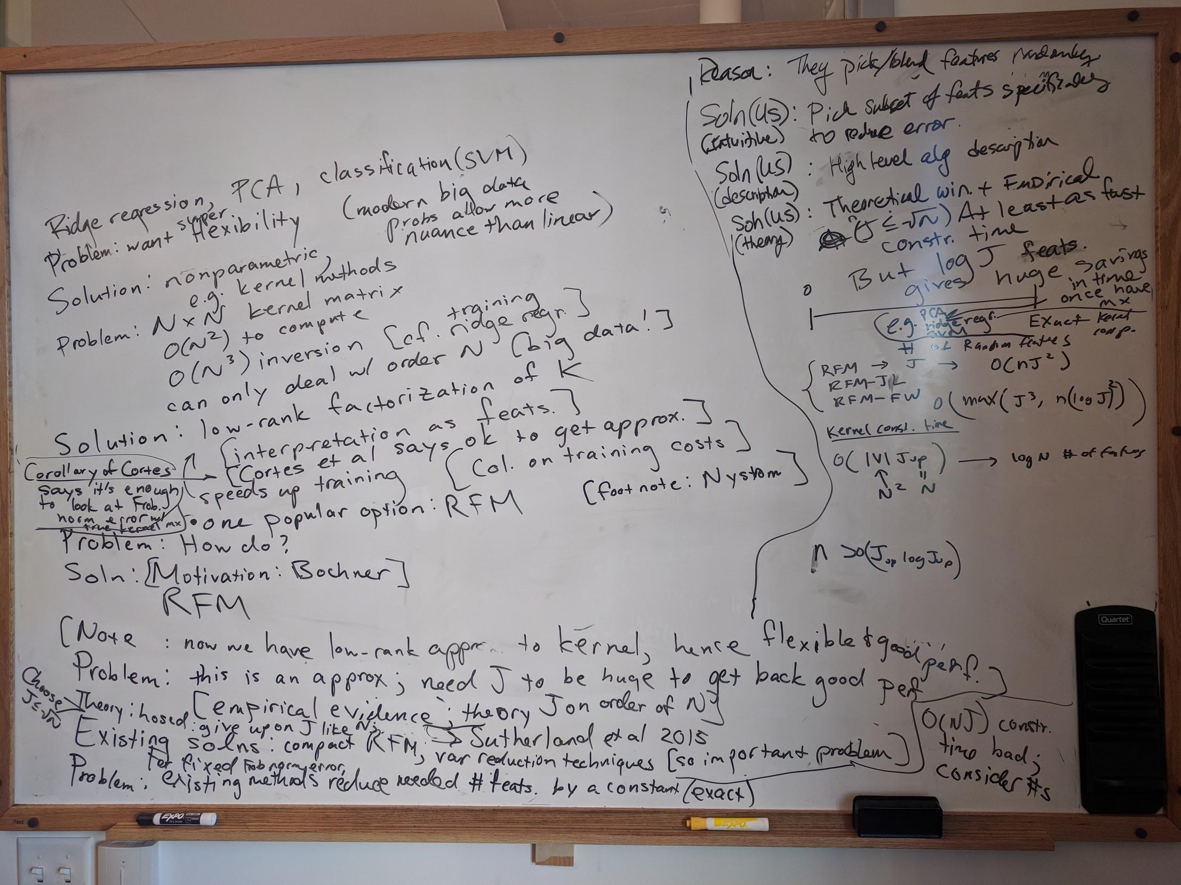
Actual storyboard for that paper
problem-solution!

Slide 16
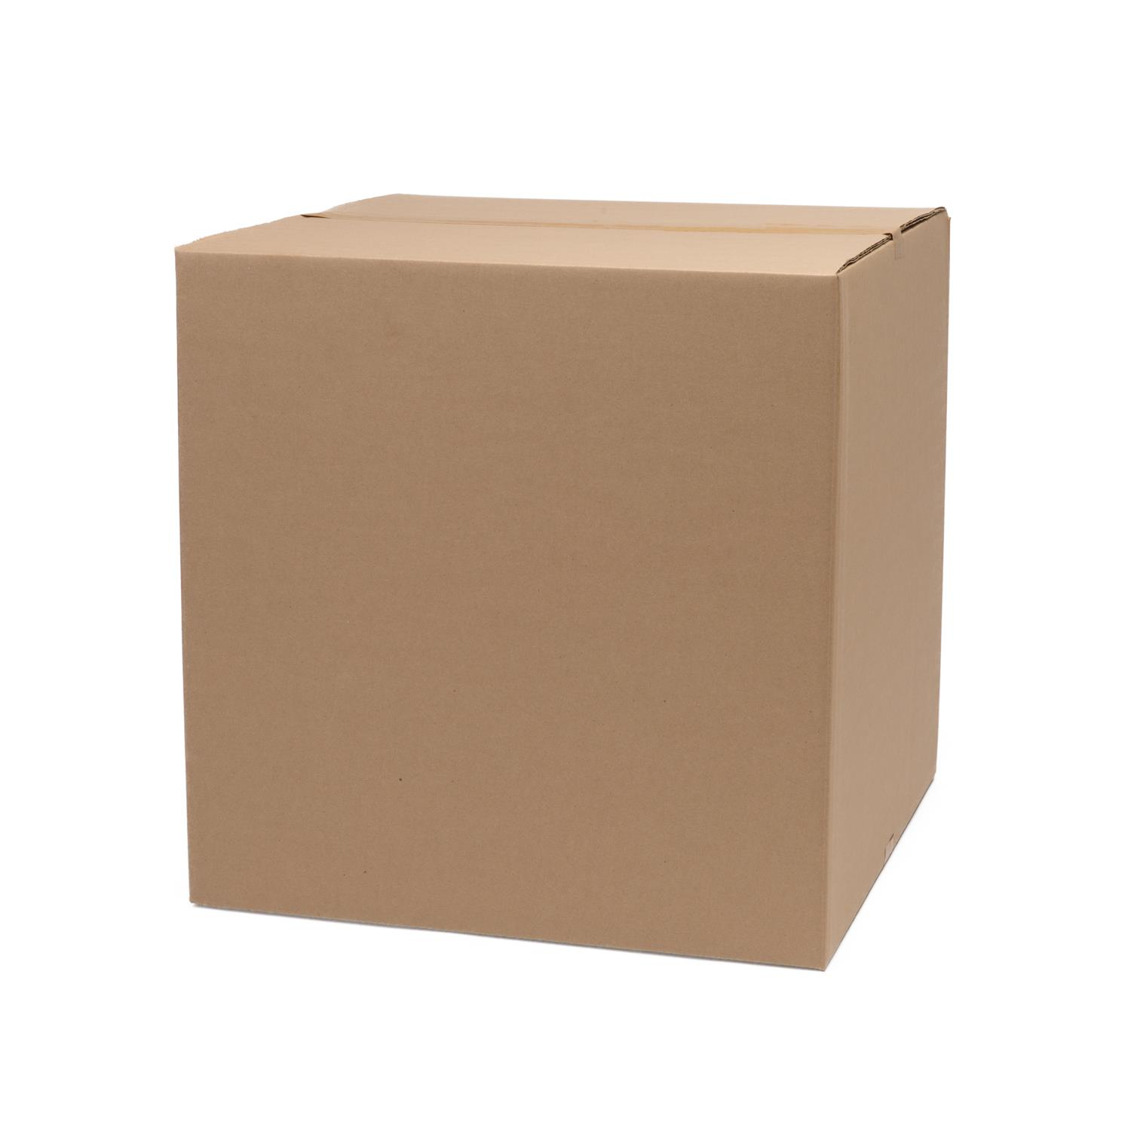
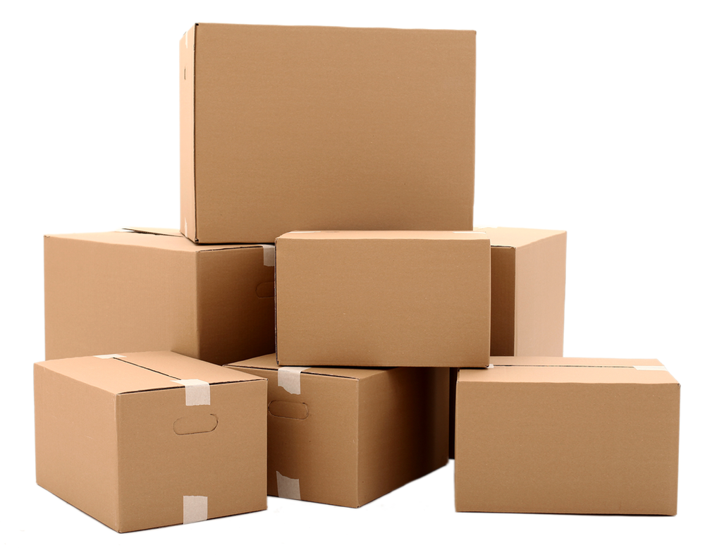
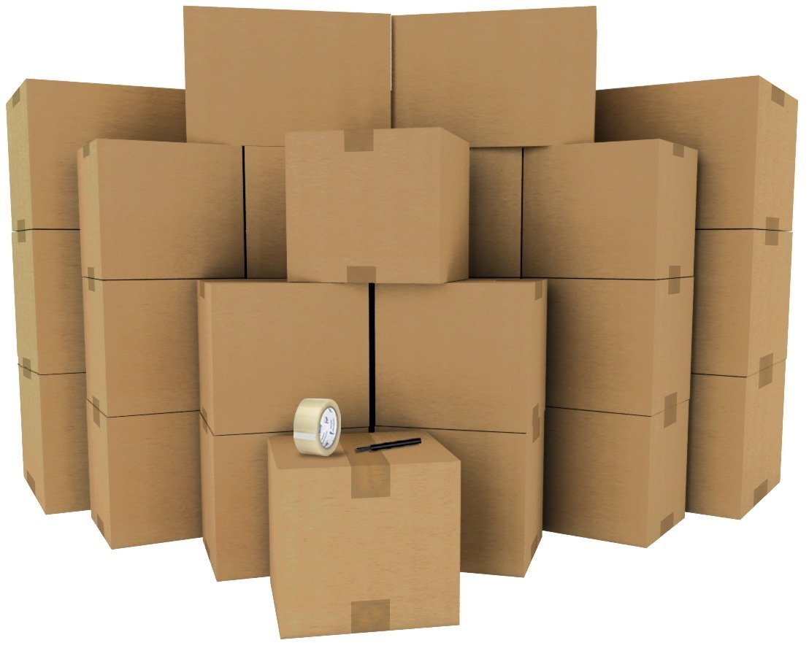
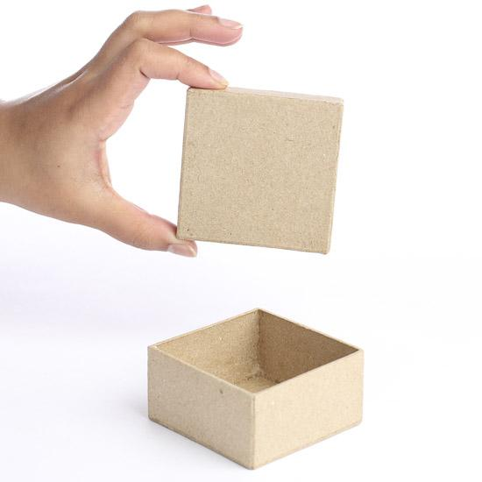
Next step: unpack your story
Tell your story ~3 times in increasing levels of detail
1: The Nutshell tell the high level story as briefly as possible
2: The Synopsis tell it with motivating examples, past work, your solution
3: The Details fill in important details; don’t lose sight of flow
For talks, 0: The Sentence - A single sentence story during the title slide

Slide 17

Next step: unpack your story
Think of your technical presentation as a bad joke
You start with the punchline, and then repeatedly explain it in increasing detail

Slide 18
Why unpack?
It Reduces Cognitive Load your audience can predict what you’re about to tell them
It’s Humane accounts for different attention spans
It’s Robust repeated info adds redundancy

Slide 19
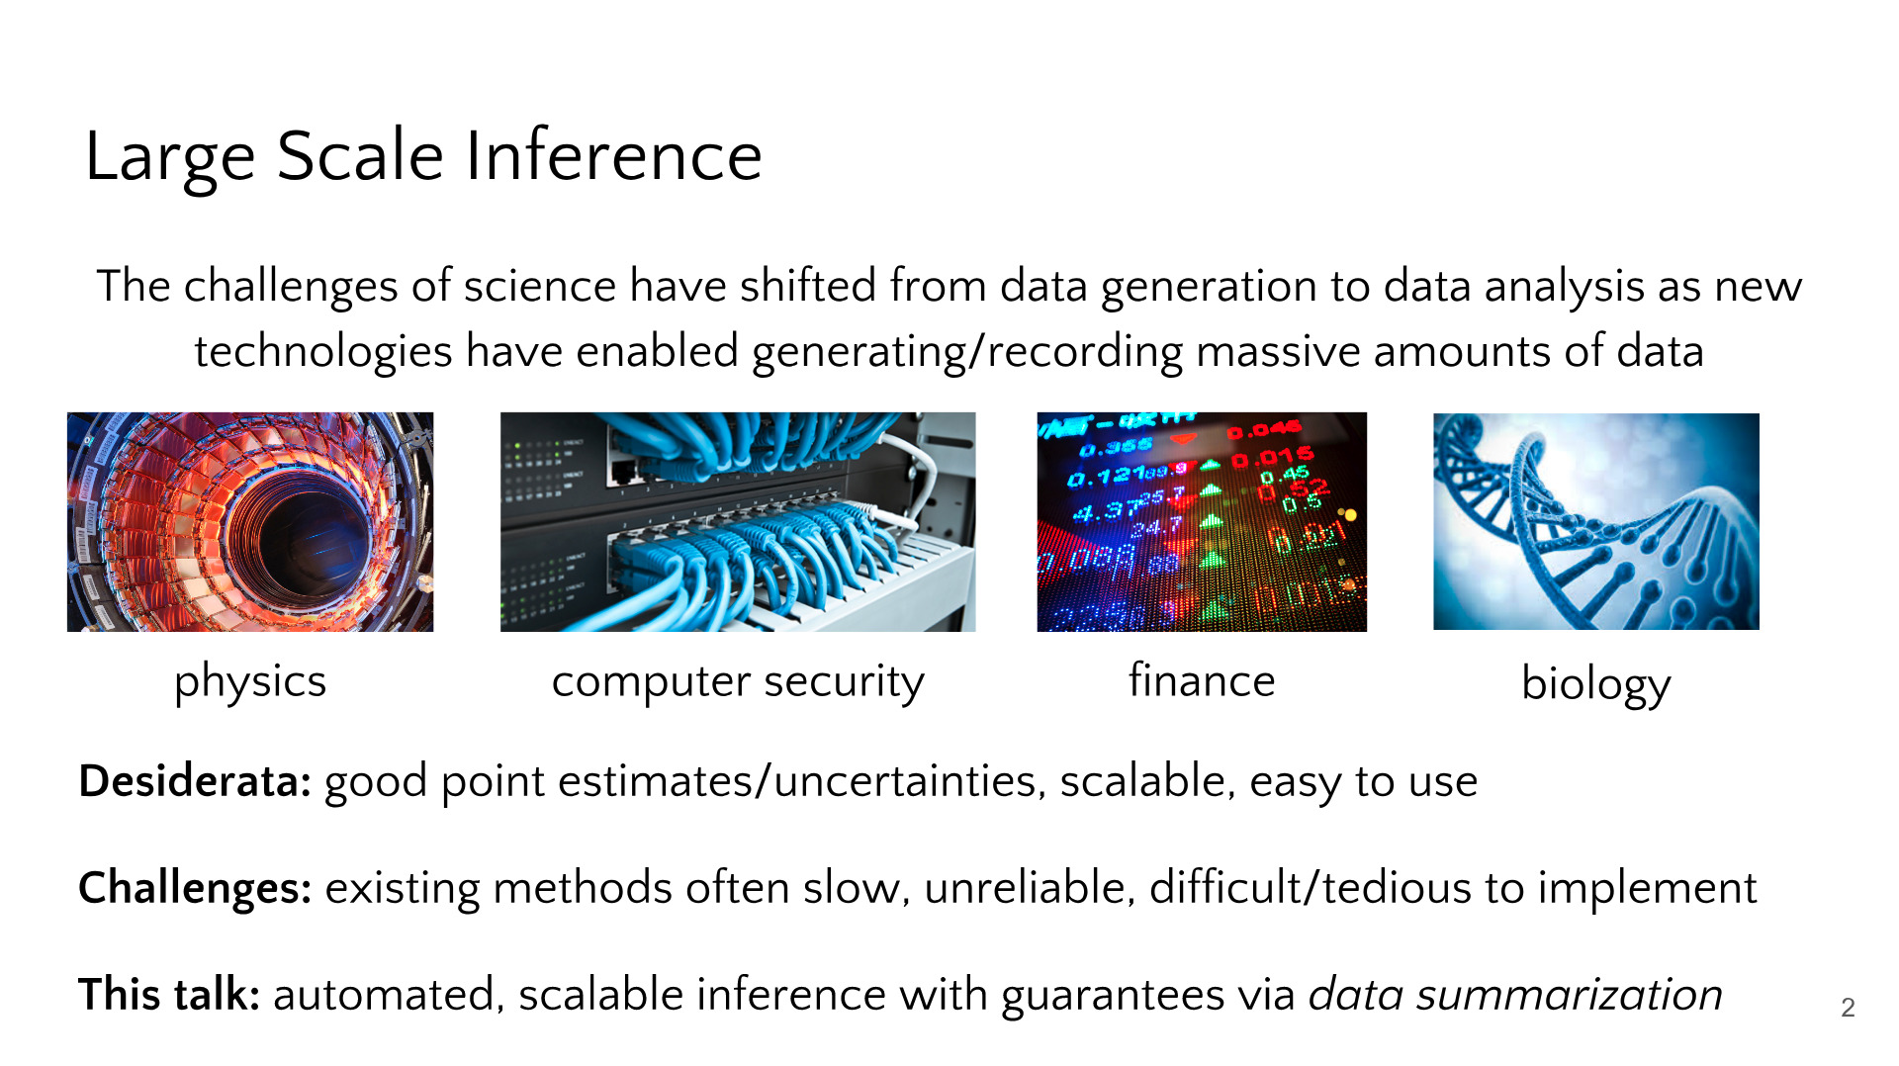
Example from one of my talks
The Nutshell
The Nutshell
The Sentence “In this talk, I’ll describe some recent work on data summarization for large-scale posterior inference”

Slide 20
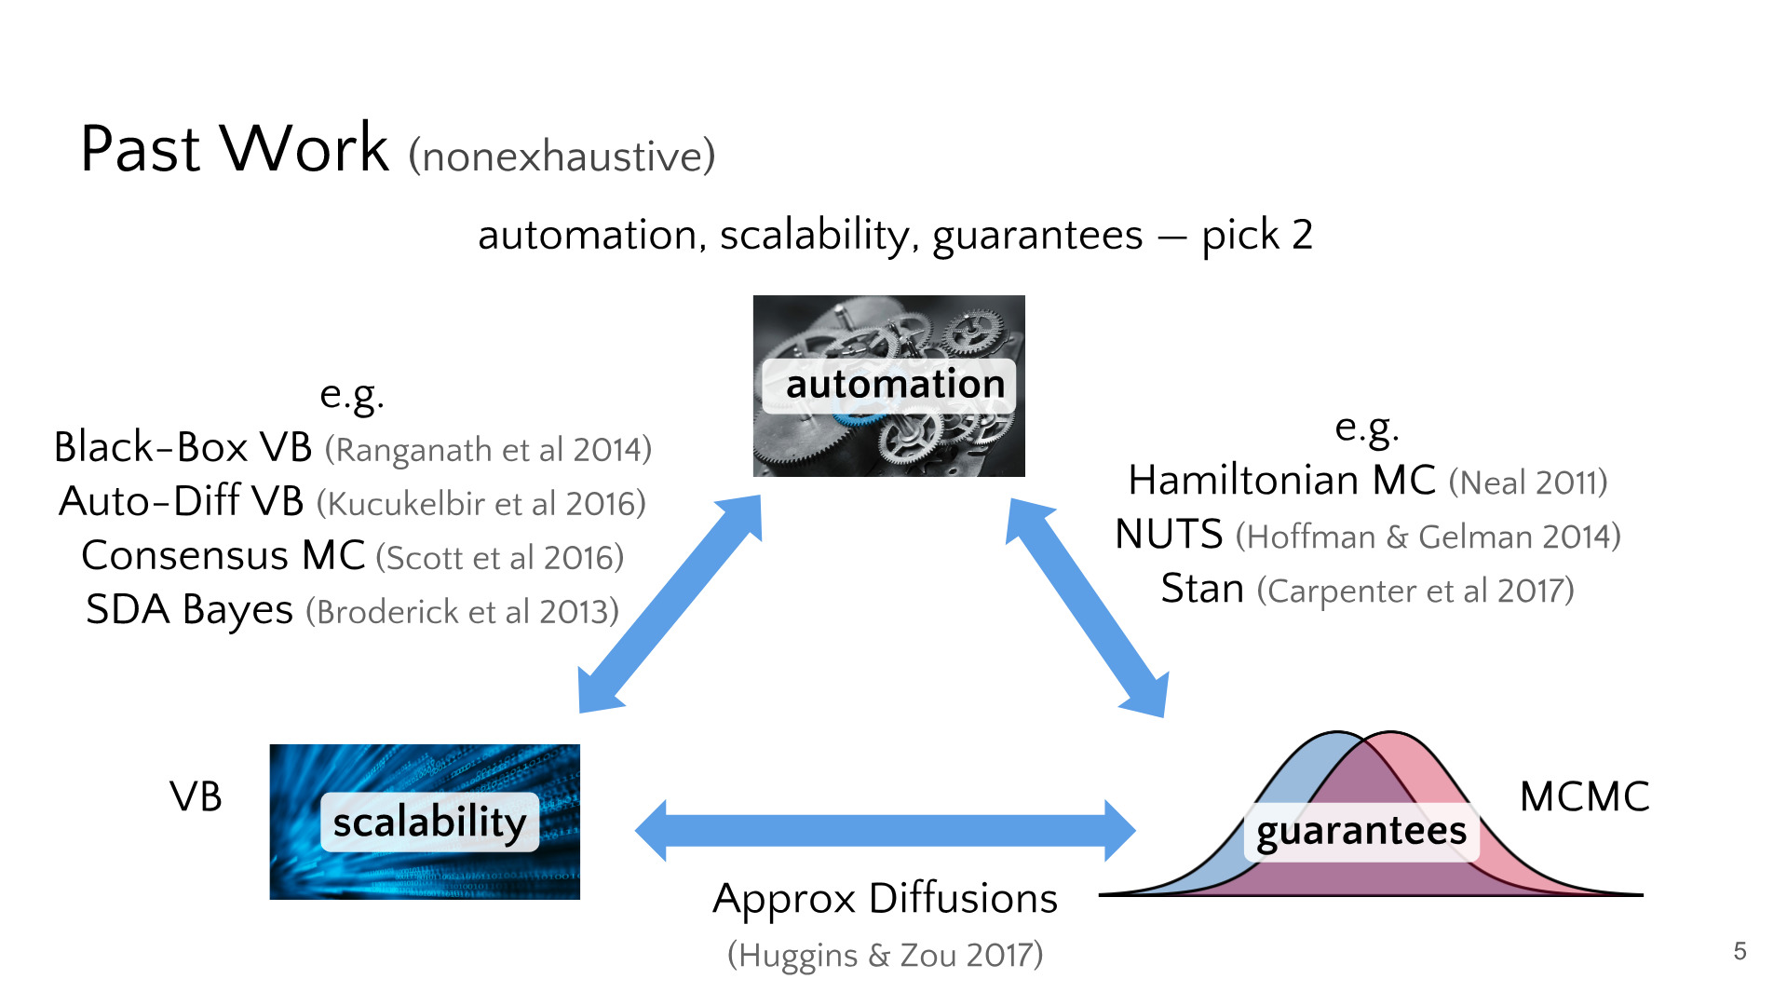
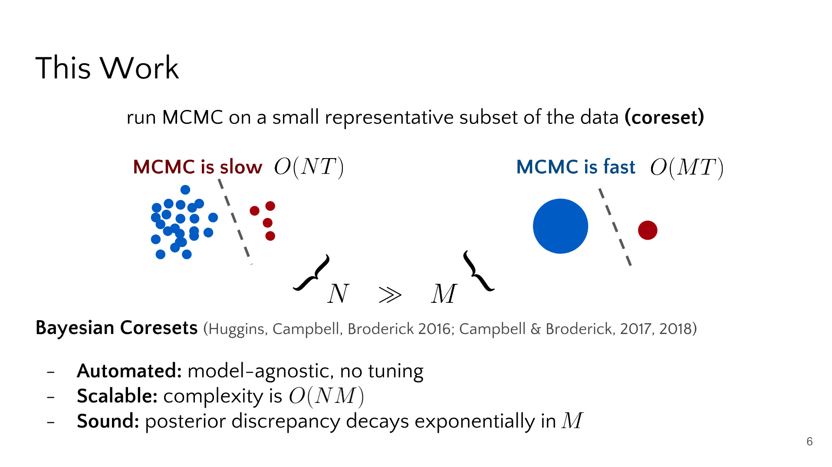
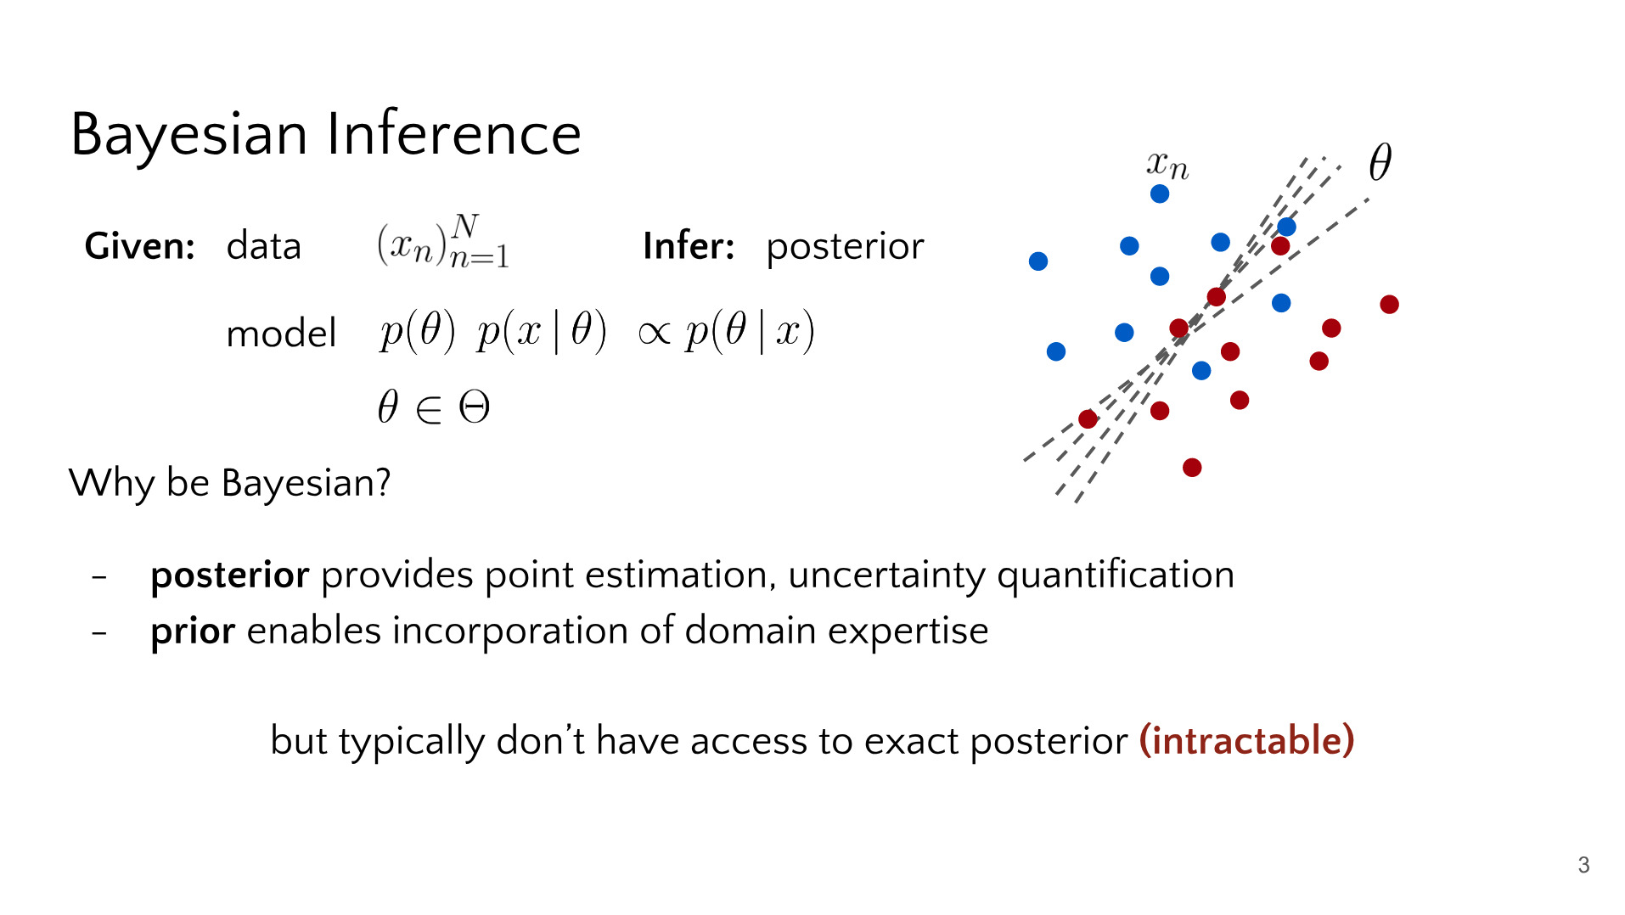
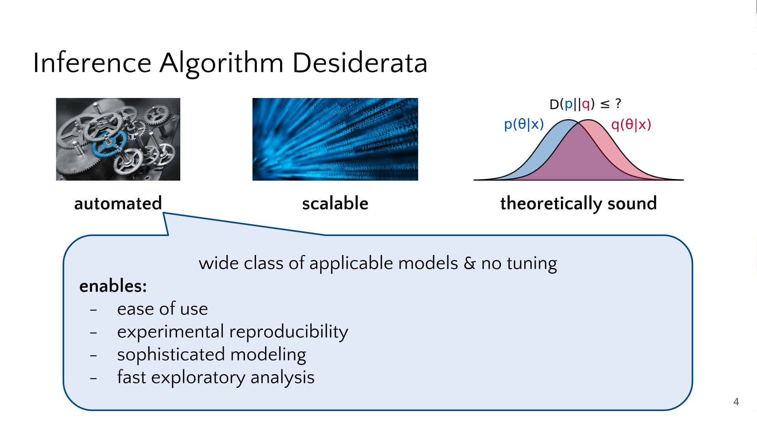
Example from one of my talks
The Synopsis
The Details https://docs.google.com/open?id=15VJn5-jaYOHhfm8I3DsMvXZW29aYMUBtJwSYaeL1dQM

Slide 21
Summary
Use problem-solution to storyboard
Rule 2
Present your research as a story.
Unpack your story in ~3 levels of detail

Slide 22
2. Filling in the Details keeping cognitive load in mind

Slide 23
Start Lazy
Material creation is the most time-consuming include the minimal material for your story (follow problem-solution, unpacking) don’t worry about polish yet
Then you’ll be left with things like...

Slide 24





A Theorem
Theorem
Define to be a polytope in two dimensional Euclidean space with the number of 1-dimensional facets strictly less than 4 and strictly greater than 2. Suppose that of the 1-dimensional facets, at least two form a juncture such that the dot products of their respective unit direction vectors is equal to 0. Denote the squared lengths of the facet i as . Then the sum of the forming the orthogonal junction is equal to the sum of the remaining .
High
cognitive load
T. Campbell
How to Explain Things
16/03/2019

Slide 25
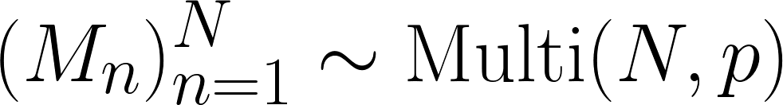
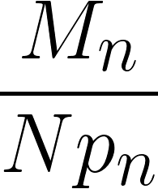
Importance Sampling
Start with a large dataset of individual points
Then compute a set of weights for each of your data points
the weights represent importance or sensitivity
Next, use a multinomial distribution to sample:
Use the weights
High
cognitive load
T. Campbell
How to Explain Things
16/03/2019

Slide 26
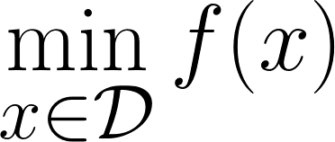
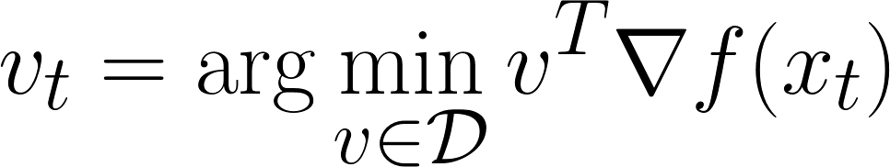
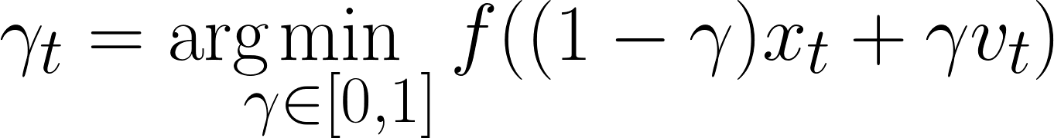
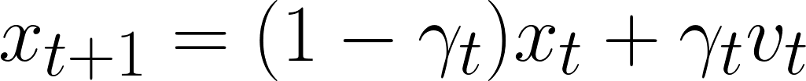
Convex Optimization
Iteration:
High
cognitive load
T. Campbell
How to Explain Things
16/03/2019

Slide 27
Comparison
ALG-A outperforms ALG-B
# iterations | ALG-A Time (s) | ALG-A Obj | ALG-B Time (s) | ALG-B Obj
1 | 0.032±0.002 | 38573.233 | 0.066±0.001 | 40293.384
5 | 0.053±0.003 | 28594.534 | 0.099±0.001 | 35184.299
10 | 0.104±0.005 | 21829.263 | 0.122±0.003 | 26183.112
50 | 0.643±0.010 | 19483.243 | 0.843±0.007 | 22347.745
100 | 2.003±0.040 | 18324.090 | 3.666±0.020 | 21293.374
500 | 7.432±0.064 | 18222.366 | 9.300±0.034 | 20934.440
1,000 | 14.637±0.152 | 18192.286 | 19.234±0.111 | 19200.577
5,000 | 19.523±0.232 | 18187.253 | 30.534±0.155 | 18603.784
Super high
cognitive load
T. Campbell
How to Explain Things
16/03/2019

Slide 28
A description
There are a lot of advantages to our novel algorithm
It is 50 times faster than competing state-of-the-art
It provides more reliable solutions
It comes with guarantees on of solution quality
It is robust to large quantities of noise
High-ish cognitive load
T. Campbell
How to Explain Things
16/03/2019

Slide 29
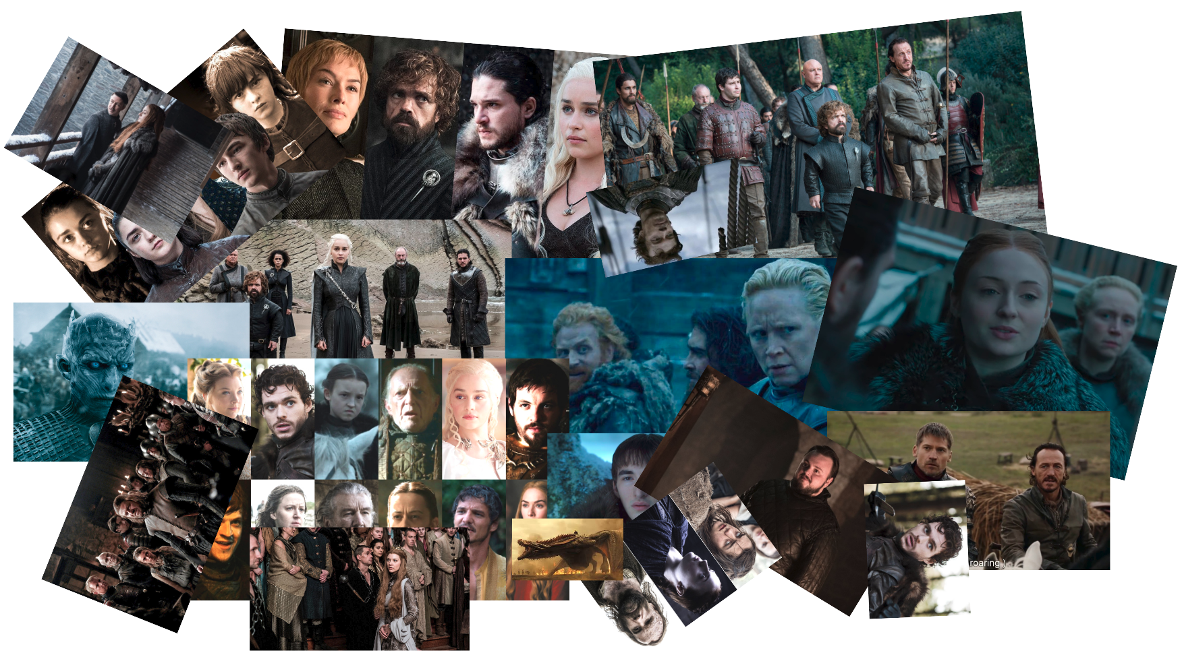
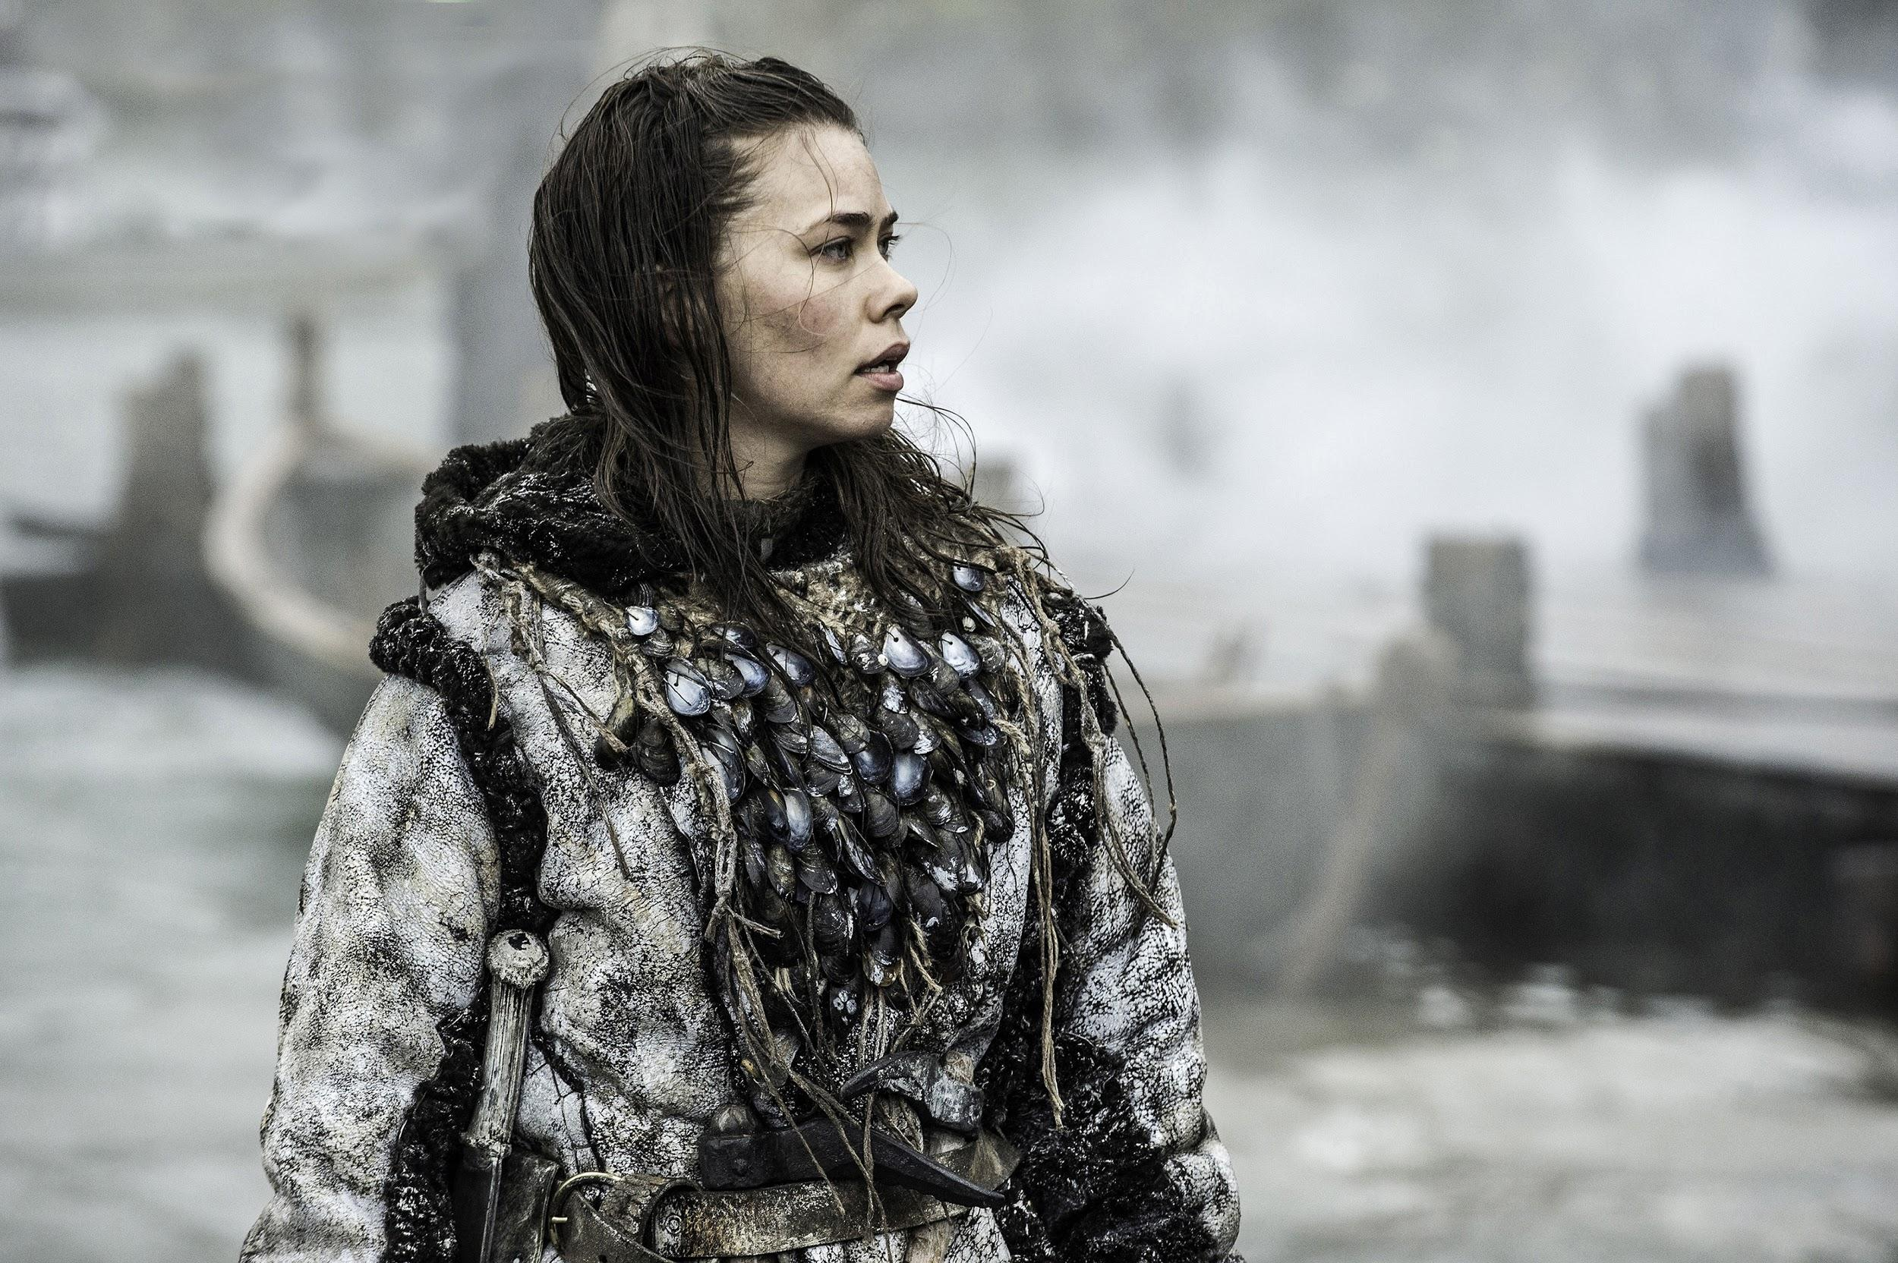
Like a story with too many characters / plotlines
I legitimately don’t recall who this is...
From: Game of Thrones

Slide 30
Minimizing cognitive load
How can we make these examples less taxing?
simplify data and minimize noise
the images / math / text that convey your message
while preserving information
extraneous distractions
your message

Slide 31
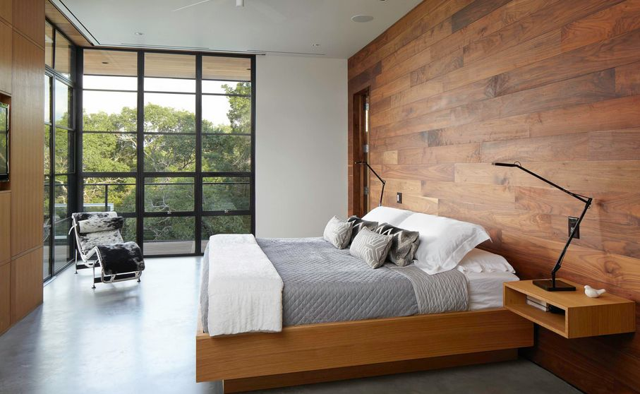
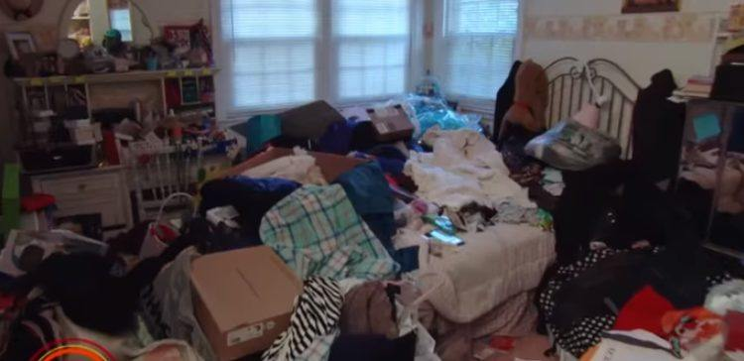
Minimizing cognitive load
Think of your technical material as a minimalist interior design
Message: “a chair complements a bed nicely”
simple data, low noise
complex data, high noise
easy on the brain
is there even a chair…?

Slide 32
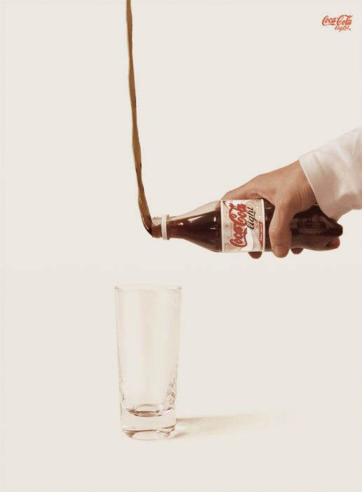
Minimizing cognitive load
Think of your talk as an advertisement for your paper
pithy, minimal, informative, punchy, compelling

Slide 33
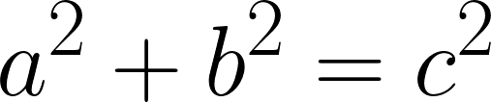
A Theorem
simplify data
Theorem
Define to be a polytope in two dimensional Euclidean space with the number of 1-dimensional facets strictly less than 4 and strictly greater than 2. Suppose that of the 1-dimensional facets, at least two form a juncture such that the dot products of their respective unit direction vectors is equal to 0. Denote the squared lengths of the facet i as . Then the sum of the forming the orthogonal junction is equal to the sum of the remaining .
Theorem
Define to be a polytope in two dimensional Euclidean space with the number of 1-dimensional facets strictly less than 4 and strictly greater than 2. Suppose that of the 1-dimensional facets, at least two form a juncture such that the dot products of their respective unit direction vectors is equal to 0. Denote the squared lengths of the facet i as . Then the sum of the forming the orthogonal junction is equal to the sum of the remaining .
Theorem
Define to be a polytope in two dimensional Euclidean space with the number of 1-dimensional facets strictly less than 4 and strictly greater than 2. Suppose that of the 1-dimensional facets, at least two form a juncture such that the dot products of their respective unit direction vectors is equal to 0. Denote the squared lengths of the facet i as . Then the sum of the forming the orthogonal junction is equal to the sum of the remaining .
Theorem
Define to be a polytope in two dimensional Euclidean space with the number of 1-dimensional facets strictly less than 4 and strictly greater than 2. Suppose that of the 1-dimensional facets, at least two form a juncture such that the dot products of their respective unit direction vectors is equal to 0. Denote the squared lengths of the facet i as . Then the sum of the forming the orthogonal junction is equal to the sum of the remaining .
this is a triangle
with a right angle
T. Campbell
How to Explain Things
16/03/2019

Slide 34


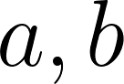

A Theorem
simplify data
Theorem: For
We have that:
Theorem
For a triangle with right angle side lengths and hypoteneuse length
but why not use even more human-friendly data?
T. Campbell
How to Explain Things
16/03/2019

Slide 35
A Theorem
minimize noise
wasted space
doesn’t matter
Theorem: For
We have that:
I hope they know this too...
You already introduced yourself
audience already knows this
wasted space
T. Campbell
How to Explain Things
16/03/2019

Slide 36

Importance Sampling
Intuition: sample unique/important data more frequently, but then downweight
Start with a large dataset of individual points
Then compute a set of weights for each of your data points
the weights represent importance or sensitivity
Next, use a multinomial distribution to sample:
Use the weights
original dataset
compute data “importance”
i.i.d. subsample importance
reweight by inverse importance
lots of data, not much info
A picture is worth a thousand words (and a million math symbols)
It makes things more brain-friendly
unnecessary math
symbols not introduced
T. Campbell
How to Explain Things
16/03/2019

Slide 37
Convex Optimization
what do these steps do?
Iteration:
Iteration:
linear optimization
line search
update
lots of symbols,
also undefined
Animations are great for reducing cognitive load - can build a complex idea incrementally
T. Campbell
How to Explain Things
16/03/2019
Notes:
force you to practice / become familiar with your slides
but the animations should increase signal to noise, reduce cognitive load

Slide 38
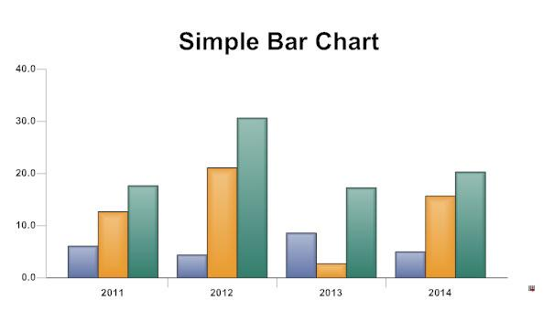
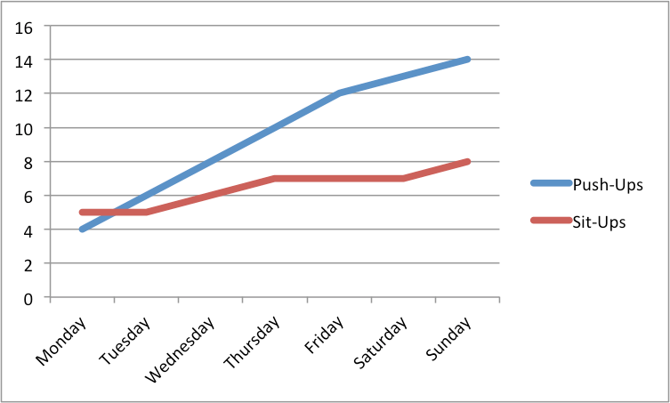
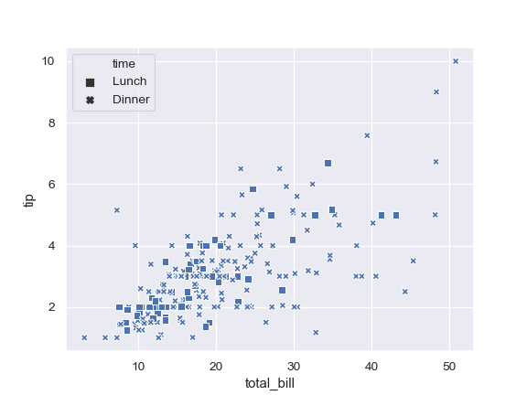
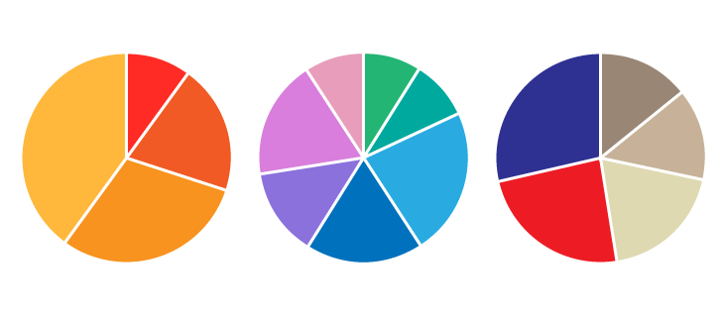
Comparison
ALG-A outperforms ALG-B
Line plot ordered data
Bar chart unordered data
# iterations | ALG-A Time (s) | ALG-A Obj | ALG-B Time (s) | ALG-B Obj
1 | 0.032±0.002 | 38573.233 | 0.066±0.001 | 40293.384
5 | 0.053±0.003 | 28594.534 | 0.099±0.001 | 35184.299
10 | 0.104±0.005 | 21829.263 | 0.122±0.003 | 26183.112
50 | 0.643±0.010 | 19483.243 | 0.843±0.007 | 22347.745
100 | 2.003±0.040 | 18324.090 | 3.666±0.020 | 21293.374
500 | 7.432±0.064 | 18222.366 | 9.300±0.034 | 20934.440
1,000 | 14.637±0.152 | 18192.286 | 19.234±0.111 | 19200.577
5,000 | 19.523±0.232 | 18187.253 | 30.534±0.155 | 18603.784
There is always a better way to convey numerical comparison than a table
yikes
Does not apply to incomparable numerics (e.g. tuning parameters, dataset sizes)
Scatter plot noisy data
Pie chart fixed-sum data
T. Campbell
How to Explain Things
16/03/2019
Notes:
note: incomparable numerics typically shouldn’t be in a talk

Slide 39
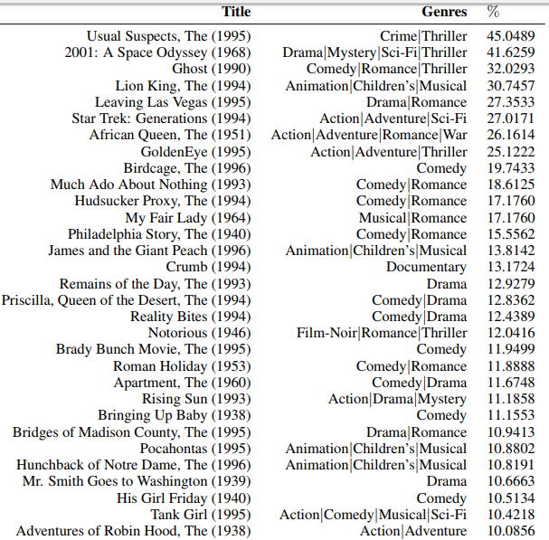
What about incomparable numerics?
Totally OK in a paper - for talks, either don’t include (tuning params) or use a summary that conveys the story
movie genres¹⁰
% of movies with each genre
Star Trek: Generations
sci-fi
adventure
%
action
sci-fi
adventure
action

Slide 40
A description
There are a lot of advantages to our novel algorithm
It is 50 times faster than competing state-of-the-art
It provides more reliable solutions
It comes with guarantees on of solution quality
It is robust to large quantities of noise
[Algorithm Name]
50 times faster than competitors
more reliable
has quality guarantees
robust to high noise
unnecessary text to parse
T. Campbell
How to Explain Things
16/03/2019

Slide 41

Keep the message consistent
Common advice: “Don’t say the same thing as your slides” Translation: the data should not be the same
visual message (slide) and audio message (voice) should be the same
Reduces context switching

Slide 42
Summary
Simplify data
Rule 1
Minimize cognitive load.
Remove noise
Preserve the message

Slide 43
3. Making it Shine important considerations and less important opinions

Slide 44
Colour Palettes
Text / background: high contrast, low saturation colour schemes
Illegible not enough contrast
Tiring
too much saturation
Comfortably Readable
Here is some text
Here is some text
Here is some text
Black text on a white background maximizes readability (maximizes contrast, minimizes saturation) Opinion: It also is the least distracting (minimize noise!)

Slide 45
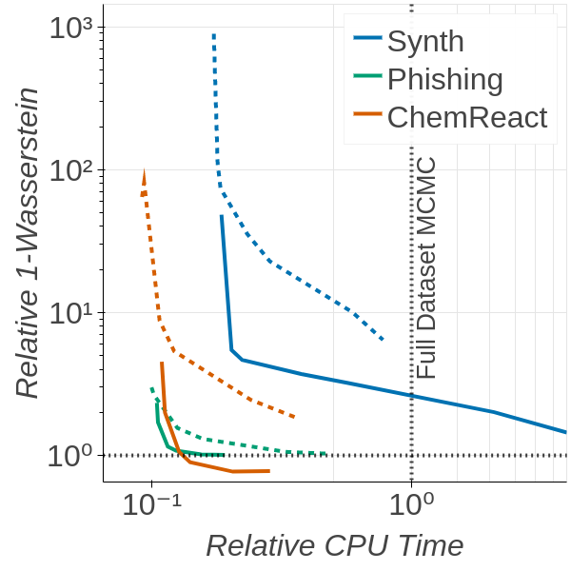
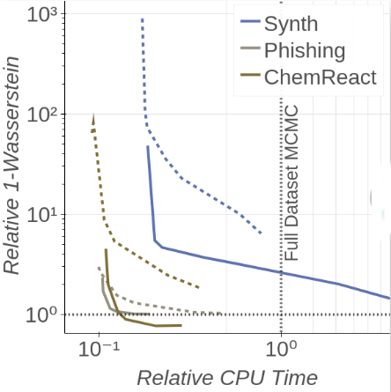
Colour Palettes
Plots: high contrast colours, taking into account colourblindness
Example from my own work:
normal vision
red blind
https://www.canvasflip.com/color-blind.php

Slide 46
Fonts & Sizes
Talks and posters: a neutral, light typeface, sans serif font is most readable
Oh boy all of these are pretty horrible (ow, right in my signal-noise ratio!)
My Typical Choices:
Helvetica Neue Light
Font size should make 1 slide title + 10 lines 1.5-spaced
these slides have 28pt title, 18pt main text, 14pt annotations

Slide 47


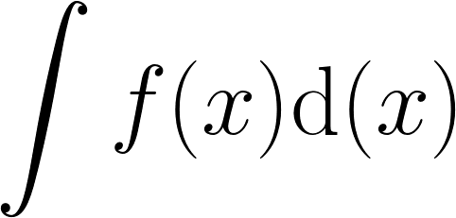
Tools
Opinion: avoid Beamer
encourages copy + paste of LaTeX math, text, etc from your paper
most themes are high noise
float placement is a pain
I’ve heard: PowerPoint and Keynote both pretty good now
I use: with for math
risk: Google / Code Cogs stop supporting them
downside: exporting to PDF / PowerPoint with animations not fantastic

Slide 48
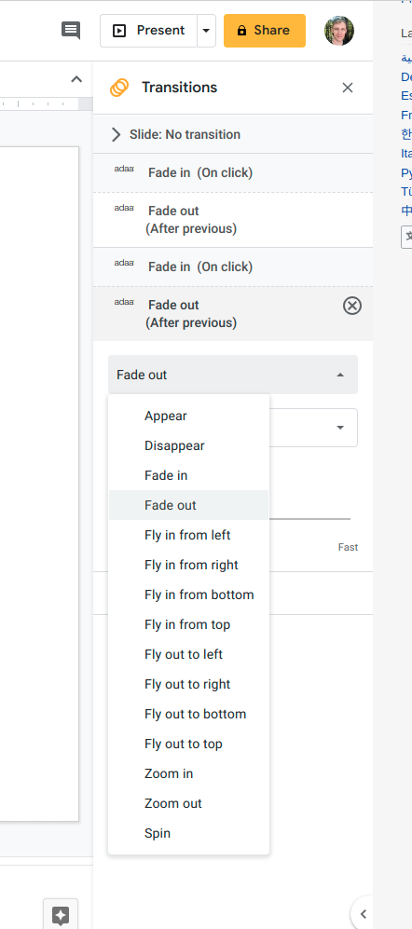
Animations
{
These are OK when used carefully
These typically just add noise

Slide 49
Talk Length
Include the right amount of material and practice to get timing right
Time Limit
Audience patience
Audience comprehension
Time
# Skipped Slides
My rules of thumb:
start with # slides = ¾ * minutes
practice the opening ~5-7 mins a lot; practice the rest until comfortable

Slide 50
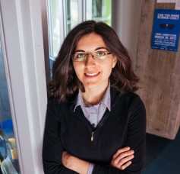
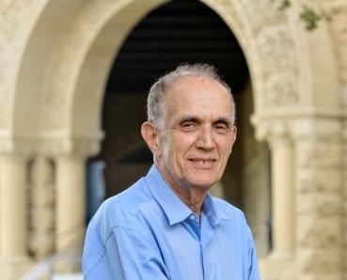
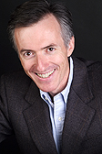
From Whom I Stole These Ideas
Tamara Broderick http://www.tamarabroderick.com/ (problem-solution; unpacking)
Brad Efron http://statweb.stanford.edu/~ckirby/brad/other/2013ThirteenRules.pdf (thirteen rules) Jean-Luc Doumont http://www.principiae.be/ (reduce cognitive load; minimize noise)

Slide 51
Summary
Problem-Solution your story
Unpack into ~3 levels to create flow
Add Material following the flow you developed
Simplify Data while preserving your message
Remove Noise that distracts from your message
Polish
choose readable fonts / backgrounds
use colour palettes that work for everyone
rehearse your talk (especially the opening)
I’ll post these slides at www.trevorcampbell.me to use as a reference

Slide 52
References
Cowan (2000), “The magical number 4 in short-term memory: A reconsideration of mental storage capacity.” Behavioral and Brain Sciences 24, 87-185.
Miller (1956), “The magican number 7, plus or minus two: Some limits on our capacity for processing information.” Psychological Review 63(2), 81-97.
Atkinson & Shiffrin (1968), “Chapter 2: Human memory: A proposed system and its control processes.” In Spense & Spense, The psychology of learning and motivation 2, New York: Academic Press, pp. 89-195.
Rubinstein et al. (2001), “Executive control of cognitive processes in task switching.” Journal of Experimental Psychology: Human Perception and Performance 27(4), 763-797.
Interview: Clifford Nass. Frontline, Public Broadcasting Service. Available online: https://www.pbs.org/wgbh/pages/frontline/digitalnation/interviews/nass.html , accessed 2019/03/06.
Oaks (1995), “Storytelling: A natural mnemonic: A study of a storytelling method to positively influence student recall of instruction.” Ph.D. Thesis, The University of Tennessee.
Stephens et al. (2010), “Speaker-listener neural coupling underlies successful communication.” Proceedings of the National Academy of Science 107(32), 14425-14430.
Smith et al. (2017), “Cooperation and the evolution of hunter-gatherer storytelling.” Nature Communications 8(1853).
Agrawal et al (2019), “Data-dependent compression of random features for large-scale kernel approximation.” Artificial Intelligence and Statistics (AISTATS)
Wang et al (2017), “Robust probabilistic modeling with Bayesian data reweighting.” International Conference on Machine Learning (ICML).

